Slide 1
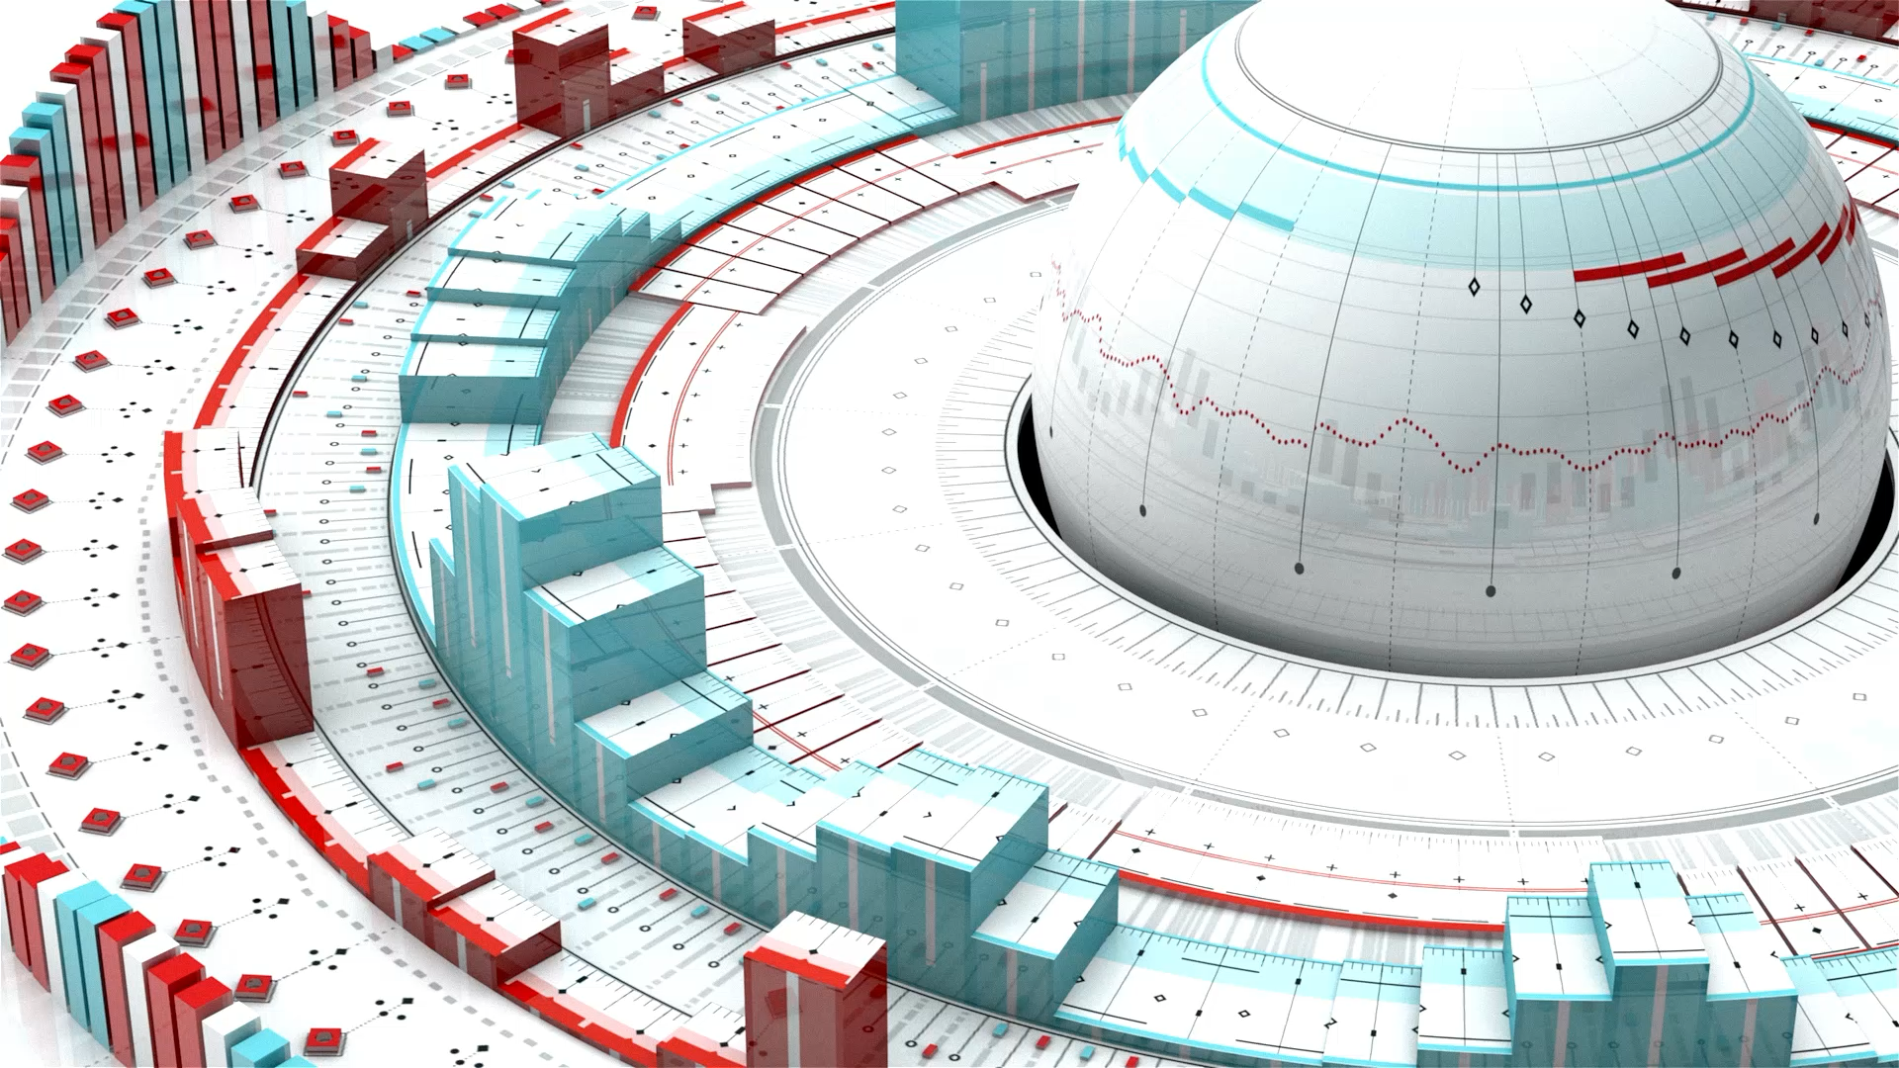
Design and Analysis of Cache Architecture
Yusuf Taha Öncü

Slide 2

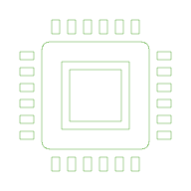
Introduction
The primary objective of this project was not just to achieve the highest possible performance, but to find the most optimal and cost-effective cache configuration for different types of memory workloads. To do this, I analyzed five distinct memory traces using a simulator, testing variables like Cache Size, Associativity, and Block Size. To implement this variables I created a 9 Test system for all 5 trace.

Slide 3

Trace 1: Temporal Locality
Trace 1, which consisted of a repeating pattern of addresses: 16, 24, and 128. My analysis showed that this workload exhibits strong "Temporal Locality.”
In my experiments, the system initially experienced compulsory misses because the cache was empty. However, once the data was loaded, every subsequent access resulted in a hit because the loop kept requesting the same data. I tested increasing the associativity to 2-Way and 4-Way, but it provided no additional performance benefit. Therefore, I concluded that the optimal design for this workload is the simplest one: a Direct-Mapped cache with a small capacity of 64 Bytes. This minimizes hardware cost while maintaining maximum performance.
Test ID | Cache Size | Associativity | Block Size | Policy | Total Accesses | Hits | Misses | Hit Rate
Test 1 | 128 B | Direct Mapped | 2 B | LRU | 18 | 15 | 3 | 83.3%
Test 2 | 128 B | Direct Mapped | 4 B | LRU | 18 | 15 | 3 | 83.3%
Test 3 | 128 B | Direct Mapped | 8 B | LRU | 18 | 15 | 3 | 83.3%

Slide 4
Trace 2: Spatial Locality
This was a strictly sequential pattern, counting up by 4 bytes at a time: 128, 132, 136, and so on. Unlike the first trace, this one never looked back, meaning it had zero Temporal Locality.
The results here were fascinating. When I used small Block Sizes of 2 or 4 Bytes, I got a 0% hit rate because the cache couldn't capture the next item in the sequence. However, when I increased the Block Size to 8 Bytes, the hit rate instantly jumped to 50%. This proved that "Spatial Locality" was the key factor. By loading a larger block, we effectively pre-fetched the neighbor data. Increasing associativity or cache size had no effect, so the optimal design here relies entirely on using an 8-Byte Block Size.
Test ID | Cache Size | Associativity | Block Size | Policy | Total Accesses | Hits | Misses | Hit Rate
Test 1 | 128 B | Direct Mapped | 2 B | LRU | 16 | 0 | 16 | 0%
Test 2 | 128 B | Direct Mapped | 4 B | LRU | 16 | 0 | 16 | 0%
Test 3 | 128 B | Direct Mapped | 8 B | LRU | 16 | 8 | 8 | 50%
Test ID | Cache Size | Associativity | Block Size | Policy | Total Accesses | Hits | Misses | Hit Rate
Test 1 | 128 B | Direct Mapped | 2 B | LRU | 18 | 15 | 3 | 83.3%
Test 2 | 128 B | Direct Mapped | 4 B | LRU | 18 | 15 | 3 | 83.3%
Test 3 | 128 B | Direct Mapped | 8 B | LRU | 18 | 15 | 3 | 83.3%

Slide 5
Trace 3: Random Access
The data access was completely random and sparse, jumping between addresses like 20, 480, and 312.
My simulations showed a 0% hit rate across every single configuration I tested. Because the data never repeated and had no neighbors, the cache was essentially useless. In this scenario, my engineering decision shifted to "Cost Minimization." Since I cannot improve performance, I must minimize waste. Therefore, I recommended the cheapest possible hardware—a 64-Byte Direct-Mapped cache—simply to act as a placeholder without wasting silicon area or power on a high-end system that provides no return on investment.
Test ID | Cache Size | Associativity | Block Size | Policy | Total Accesses | Hits | Misses | Hit Rate
Test 1 | 128 B | Direct Mapped | 2 B | LRU | 12 | 0 | 12 | 0%
Test 2 | 128 B | Direct Mapped | 4 B | LRU | 12 | 0 | 12 | 0%
Test 3 | 128 B | Direct Mapped | 8 B | LRU | 12 | 0 | 12 | 0%

Slide 6
Trace 4: Strided Access
The program would read a few sequential numbers, then jump 256 bytes forward, and repeat.
Technically, the addresses 0 and 256 map to the same location in a Direct-Mapped cache, which usually causes a conflict. However, my simulation proved that because the program moves forward and never returns to the old address, this conflict was harmless. Just like in Trace 2, the only thing that mattered was the Block Size. Using an 8-Byte block allowed us to capture the local sequential data, achieving a 50% hit rate. I concluded that expensive associative caches were unnecessary here, and a simple Direct-Mapped design was sufficient.
Test ID | Cache Size | Associativity | Block Size | Policy | Total Accesses | Hits | Misses | Hit Rate
Test 1 | 128 B | Direct Mapped | 2 B | LRU | 12 | 0 | 12 | 0%
Test 2 | 128 B | Direct Mapped | 4 B | LRU | 12 | 0 | 12 | 0%
Test 3 | 128 B | Direct Mapped | 8 B | LRU | 12 | 0 | 12 | 0%

Slide 7
Trace 5: Conflict and Thrashing
Test ID | Cache Size | Associativity | Block Size | Policy | Total Accesses | Hits | Misses | Hit Rate
Test 1 | 128 B | Direct Mapped | 2 B | LRU | 12 | 0 | 12 | 0%
Test 2 | 128 B | Direct Mapped | 4 B | LRU | 12 | 0 | 12 | 0%
Test 3 | 128 B | Direct Mapped | 8 B | LRU | 12 | 0 | 12 | 0%
Finally, I analyzed Trace 5, which was the most critical part of the project. This trace involved a "ping-pong" pattern, alternating constantly between address 0 and address 256.
In my first test using a Direct-Mapped cache, the system suffered from severe "Thrashing." Because both addresses wanted to use the exact same slot in the cache, they constantly evicted each other, capping my hit rate at 50%.
To solve this, I changed the design to a "2-Way Set Associative" cache. This provided two slots instead of one, allowing both Address 0 and Address 256 to stay in the cache simultaneously. The result was immediate: the hit rate jumped from 50% to 83.3%. This experiment perfectly demonstrated that while Block Size handles spatial needs, Associativity is the only solution for conflict misses.
Test ID | Cache Size | Associativity | Block Size | Policy | Hits | Misses | Hit Rate
Test 4 | 128 B | 2-Way | 8 B | LRU | 20 | 4 | 83.3%
Test 5 | 128 B | 4-Way | 8 B | LRU | 20 | 4 | 83.3%

Slide 8

Conclusion
In conclusion, this project demonstrated that there is no "one-size-fits-all" cache. For loops, we need capacity; for sequential data, we need larger blocks; and for conflicting data, we need associativity. The job of a computer architect is to identify the workload and select the hardware that delivers the required performance at the lowest possible cost.

Slide 9
Thank You!

